Slide 1
Hierarchical Aggregation for Information Visualization: Overview, Techniques, and Design Guidelines
Niklas Elmqvist, Member, IEEE, and Jean-Daniel Fekete, Member, IEEE
Maithili Mishra
Notes:
The authors have proposed a model for building, visualizing, and interacting with multiscale representations of information visualization techniques using hierarchical aggregation.

Slide 2
Motivation
Most analysts start with an overview of the data before gradually refining their view to be more focused and detailed
However, OVERVIEW is becoming increasingly difficult to effectively achieve with the ever-increasing size of real-world datasets.
The motivation of the work is to make visual representations more understandable, visually scalable and less cluttered.
Notes:
OVERVIEW is one of the most basic user tasks for information visualization and it is a vital building block for the more complex process of visual exploration—using visualization to form, test, and validate hypotheses about complex or large datasets. However, overview is becoming increasingly difficult to effectively achieve with the ever-increasing size of real-world datasets. For most basic visualization techniques that endeavor to show each item in a dataset—such as scatterplots , parallel coordinates, and treemaps—a massive number of items will overload the visualization, resulting in clutter that both causes technical scalability problems as well as hinders the user’s understanding of its structure and contents

Slide 3
HIERARCHICAL AGGREGATION FOR VISUALIZATION
Turns any visualization into a multiscale structure that can be rendered at any desired level-of-detail
Provides the user with a manageable overview
Hides any clutter arising from details
Gives a reasonable indication of the data size, extents, or distribution
Notes:
Turns any visualization into a multiscale structure that can be rendered at any desired level-of-detail
Provides the user with a manageable overview
Hides any clutter arising from details
Gives a reasonable indication of the data size, extents, or distribution

Slide 4
Follows the visual information seeking mantra: “overview first, zoom and filter, then details on demand.”
Notes:
Follows the visual information seeking mantra: “overview first, zoom and filter, then details on demand.”

Slide 5
DESIGN GUIDELINES
G1 Entity budget. Maintain an entity budget;
G2 Visual summary. Aggregates should convey information about underlying data;
G3 Visual simplicity. Aggregates should be clean and simple;
G4 Discriminability. Aggregates should be distinguishable from data items;
G5 Fidelity. Beware that abstractions may lie; and
G6 Interpretability. Aggregate items only so much so that the aggregation is still correctly interpretable within the visual mapping.
Notes:
G1 Entity budget. Maintain an entity budget;
G2 Visual summary. Aggregates should convey information about underlying data;
G3 Visual simplicity. Aggregates should be clean and simple;
G4 Discriminability. Aggregates should be distinguishable from data items;
G5 Fidelity. Beware that abstractions may lie; and
G6 Interpretability. Aggregate items only so much so that the aggregation is still correctly interpretable within the visual mapping.

Slide 6
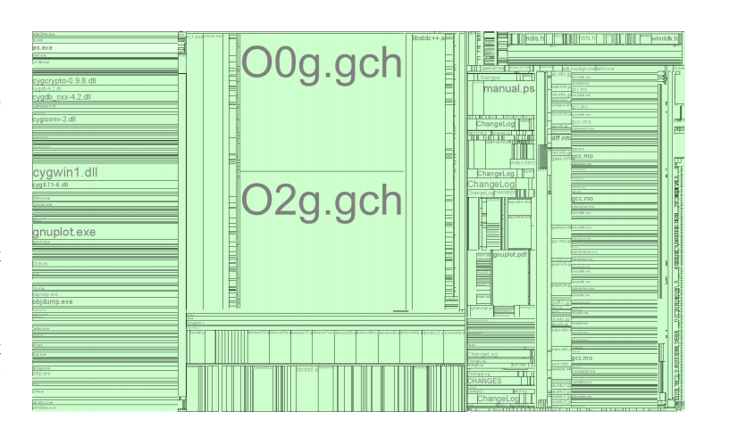
Slice-and-dice treemap visualization showing a typical Cygwin distribution for Windows (648 directories, 6552 files, 181 MB).
Notes:
We start our design from a basic slice-and-dice treemap. It is difficult, if not impossible, to get an overview of the dataset due to the large number of visual entities.

Slide 7
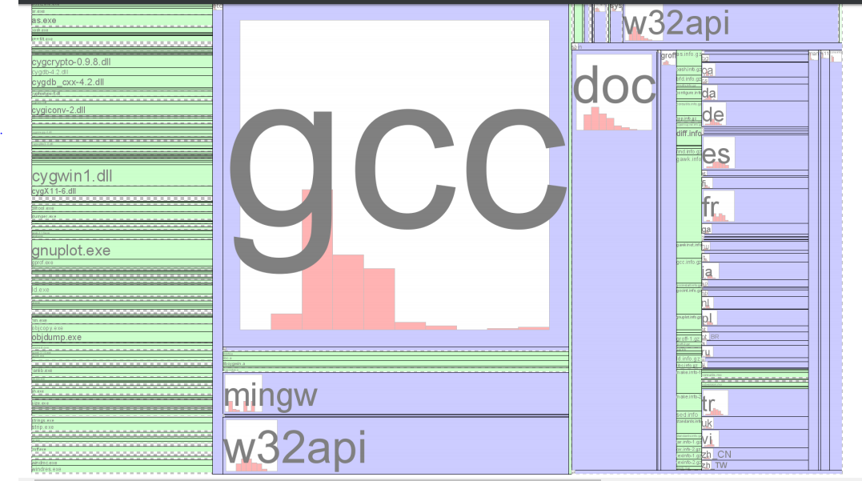
Aggregate treemap visualization of file structure
Notes:
To help remedy this situation, we can apply design guideline G1 (entity budget) to begin introducing hierarchical aggregation to the visualization. , G1 tells us that we can address both of the above problems by maintaining a visual entity budget and not propagate deeper into the aggregation hierarchy than necessary. In particular, there is clearly no need to draw any nodes that are smaller than a pixel for a given level of zoom. For this situation, we replace the visual representation of the aggregate and its children with a checkered pattern to communicate to the viewers that there is additional underlying data to be seen if they zoom in (G2). While this pattern may conflict with G3 (visual simplicity), it is better than the alternative, i.e., to attempt to draw all of the nodes, even though they are smaller than a pixel each. Furthermore, we believe that the checkered pattern still gives a clear visual indication that there is more to see in the checkered area. However, while our entity budget solves our performance problems by capping the amount of entities to draw at any time, it has not fully solved the perception problem because this budget may still be larger than the information processing capacity of the viewer. To better support overview, we introduce local aggregation control (Section 3.5.3), where the user can selectively expand and collapse branches by rolling the mouse wheel or clicking (left-click for expand and right-click for collapse) individual entities on the display. This gives the user direct control of which detail level to view the hierarchy, while simultaneously supporting drill-down and roll-up operations. According to guideline G4, we must now make sure that aggregates and items can be easily distinguished. We achieve this by coloring aggregates blue, while items remain green. This also gives a straightforward indication that there is more information to be gleaned if the user simply expands a specific aggregate. solution is to introduce a family of simple glyphs (similar to the glyphs in the ZAME [28] system) drawn in the corner of each treemap node that show various metrics of the contained subtree. In particular, we use a small bar histogram to show the distribution of file sizes in a directory structure. However, at this point, we note that the rectilinear appearance of a histogram rendered as a bar chart may be easily confused with the rectilinear visual representation of the treemap. This conflicts with guideline G4, which states that visual aggregates should be easily distinguishable, as well as to some extent G3, which argues for a clean visual appearance of visual aggregates. To avoid this conflict, we must find a visual appearance for the histogram glyph that is easily distinguishable from the treemap representation. One option may be to round the edges of the bar chart glyph, but this may not be sufficient for accurate disambiguation. Instead, we choose to add a new type of glyph based on pie charts to make the distinction perfectly clear. Another important point to consider is guideline G6, which states that taking the aggregation too far may cause misinterpretation.

Slide 8
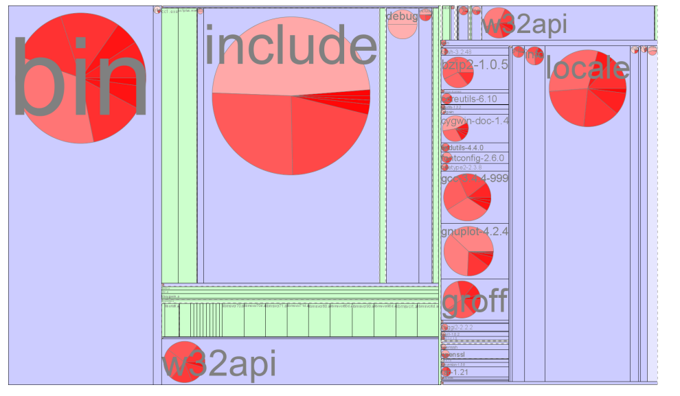
Aggregate treemap visualization of cygwin file distribution
Notes:
shows the final redesigned version of our treemap visualization, now with support for hierarchical aggregation.

Slide 9
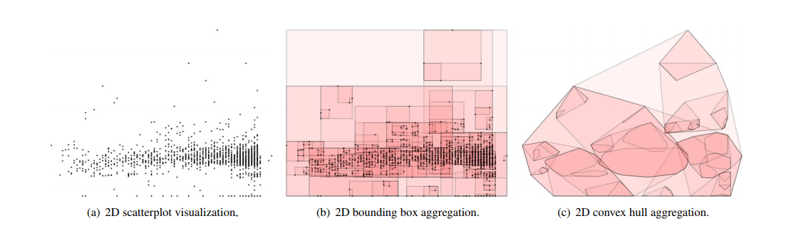
Notes:
Scatterplots are overlapping visualizations, and rendering a large dataset (or even a dataset that is locally dense) will cause a lot of item overlap in the output, making estimation of effects difficult. the main visual aggregations for scatterplots involve hierarchical clustering of data points into points, boxes, hulls, and blobs. , boxes are axis-aligned 2D or 3D bounding boxes that give an indication of the minimum and maximum values for the displayed dimensions (Figure 1(b)). They can be augmented to show averages as points or using opacity where the center point of the cluster is fully opaque and the extrema are fully transparent. Hulls are variations on boxes in that they show the extents of the displayed dimensions, but using 2D or 3D convex hulls instead of axis aligned bounding boxes as a tighter visual metric (Figure 1(c)). Just like for bounding boxes, center points or opacity can be used to indicate the cluster average.

Slide 10
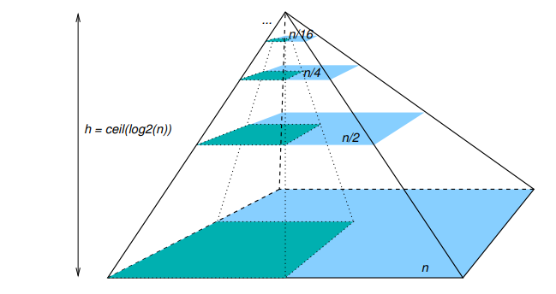
Pyramid aggregation hierarchy for the ZAME system. Each aggregate node represents four nodes in the level below
Notes:
the Zoomable Adjacency Matrix Explorer (ZAME) defines a pyramid of recursive edge merging where each level is half the dimension of the level below. Hence, each visual edge aggregate clusters four visual aggregates in the level below (Figure 14). This way, ZAME is able to visualize very large graphs on the order of 106 nodes and edges (Figure 15). Instead of fixed animations, like Matrix Zoom, the system implements many of the interaction techniques outlined in Section 3.5 of this article such as zoom and pan, drill-down/roll-up, and coupled zoom and drill.

Slide 11
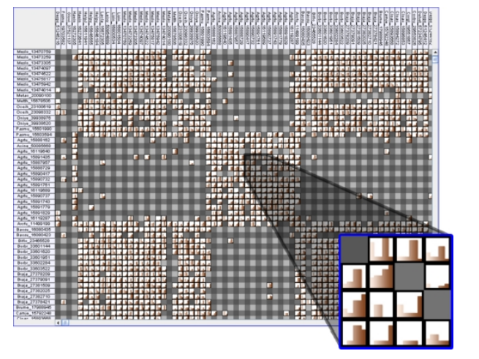
ZAME visualizing a protein-protein interaction dataset of 100,000 nodes and 1,000,000 edges. Inset shows a magnified view of step histogram edge aggregates in the matrix.
Notes:
ZAME visualizing a protein-protein interaction dataset of 100,000 nodes and 1,000,000 edges. Inset shows a magnified view of step histogram edge aggregates in the matrix.

Slide 12
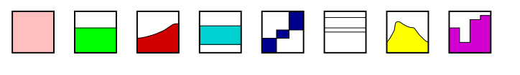
Visual edge aggregate representations for ZAME (average color shade, average, min/max curve, min/max range, min/max tribox, Tukey box, smooth histogram, step histogram)
Notes:
Visual edge aggregate representations for ZAME [28] (average color shade, average, min/max curve, min/max range, min/max tribox, Tukey box, smooth histogram, step histogram).

Slide 13
Interaction
Zoom and Pan
Drill-down and Roll-up
Local Aggregation Control
Flipping
Coupled Zooming and Drilling
Notes:
Interaction
Zoom and Pan
Drill-down and Roll-up
Local Aggregation Control
Flipping
Coupled Zooming and Drilling

Slide 14

Thank you
Notes:
Thank you

